Slide 1
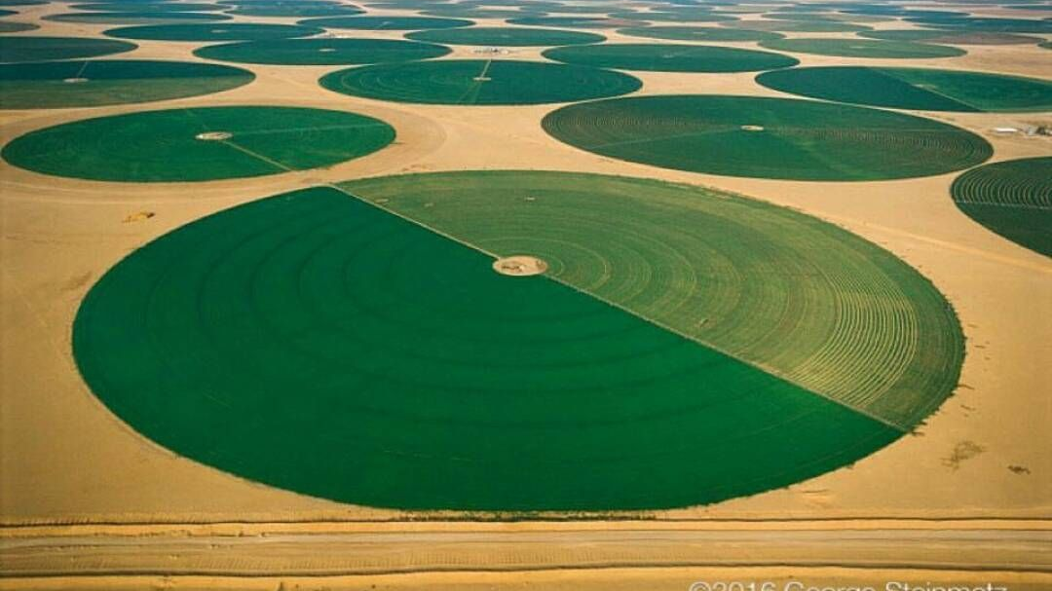
Detecting Irrigation in Brazil
Minghui Zhang

Slide 2
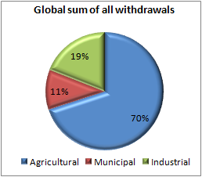
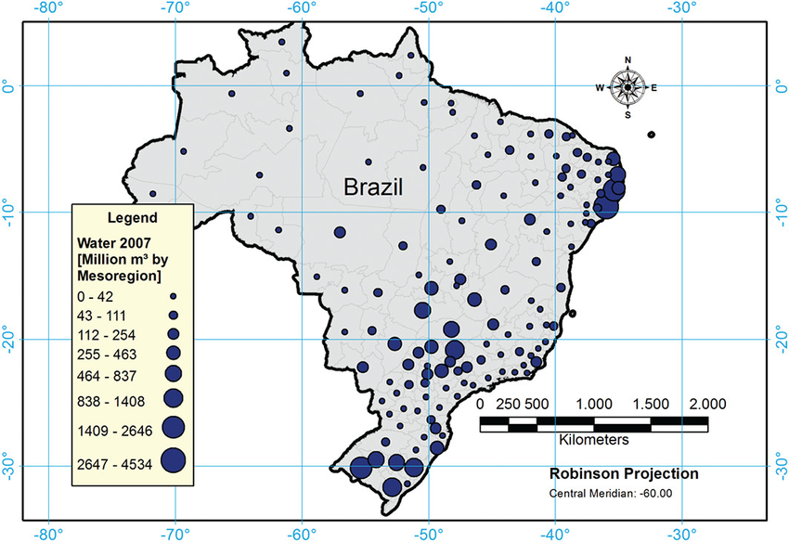
In Brazil, irrigation water use is growing thanks to improved infrastructure. The majority of irrigation is performed with center pivot.
Globally, irrigation uses more water than all other industries combined.
Our client wants to know where center pivot irrigation is growing fastest in order to provide infrastructural support to irrigation networks and to address water scarcity and environmental issues.

Slide 3
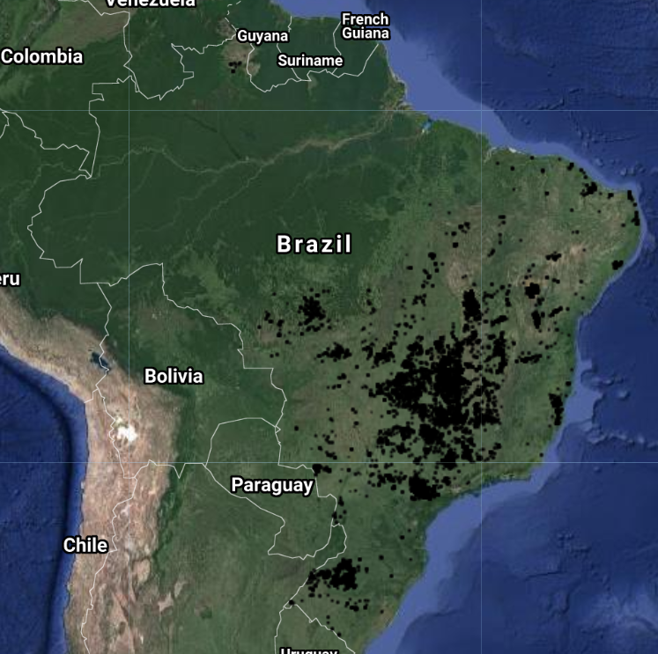
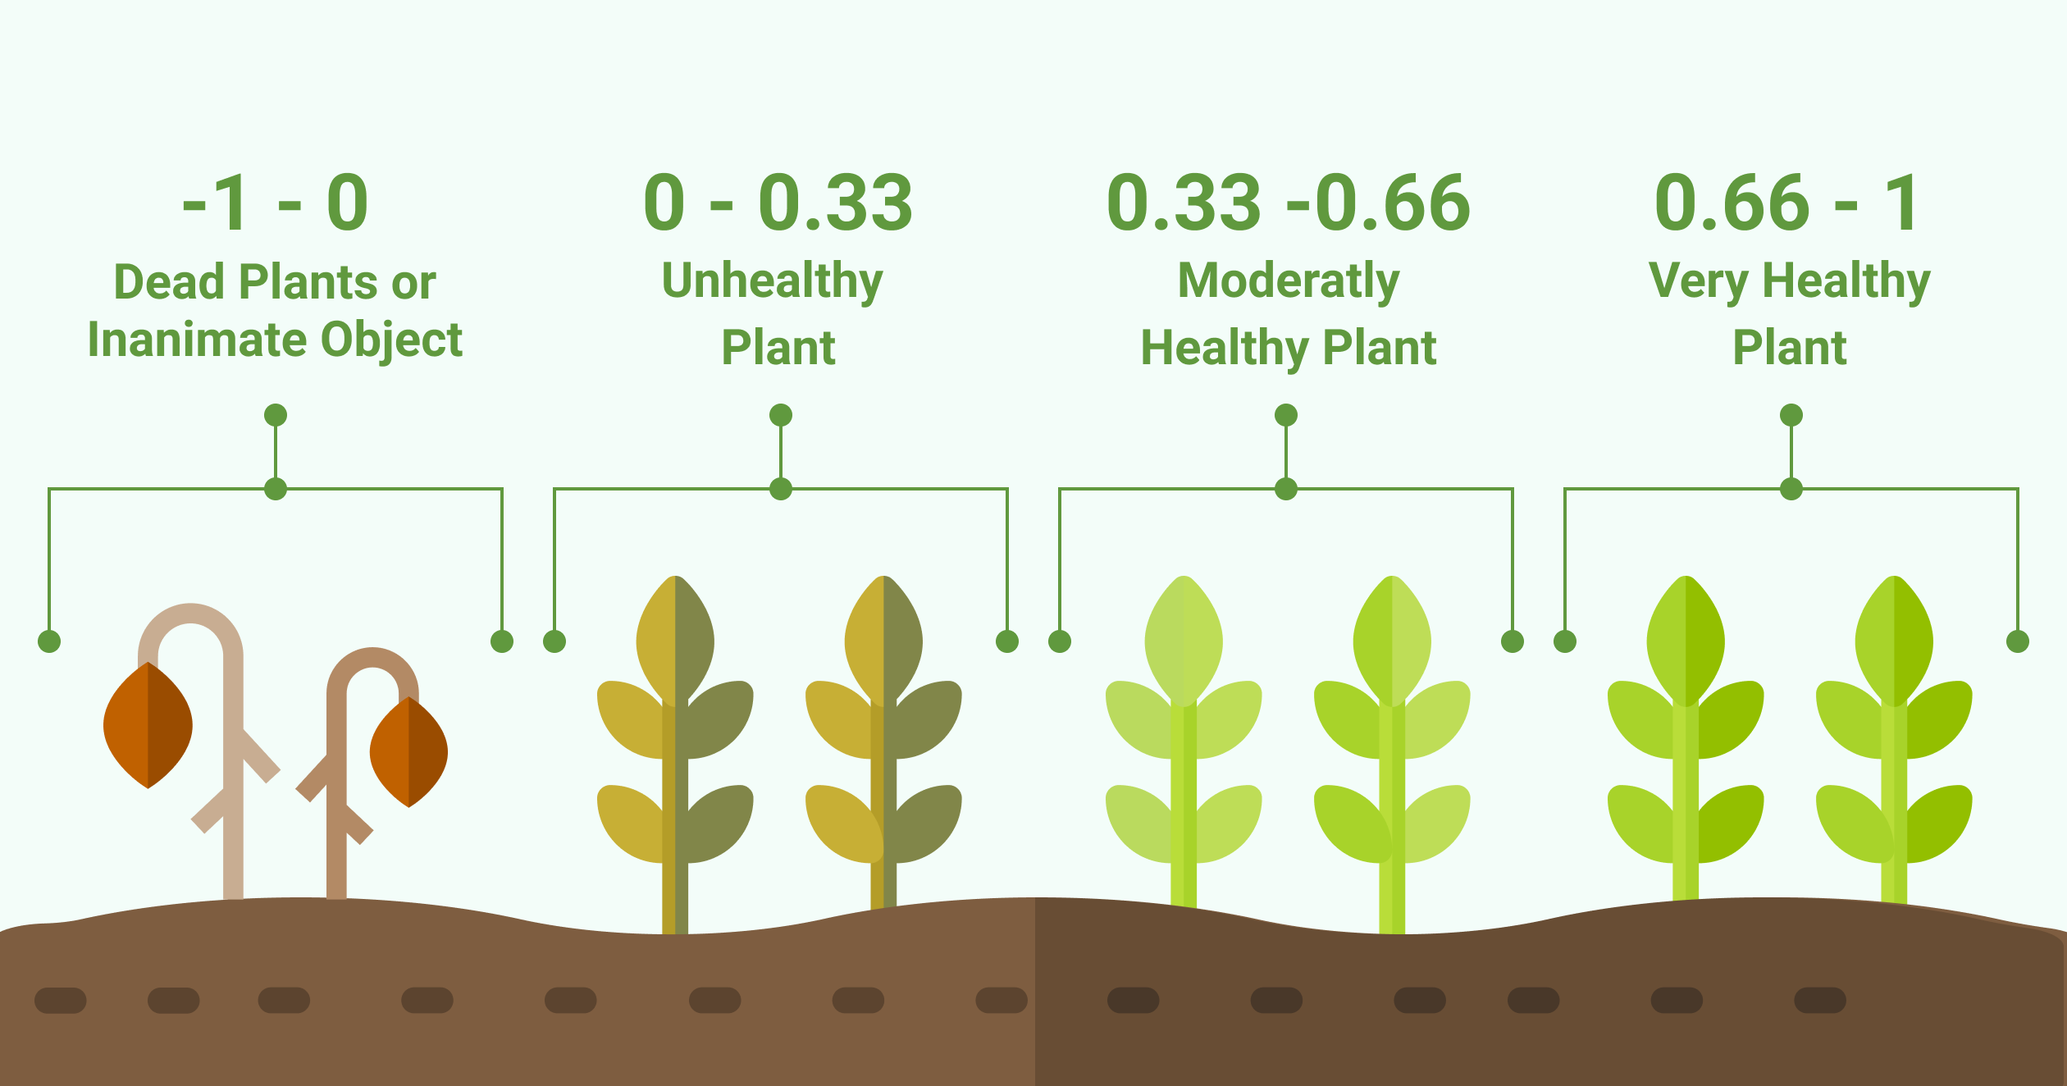
Training data
Agricultural land use map from Mapbiomas
Center pivot locations in 2014 from Embrapa
Measure of greenness (EVI) calculated from MODIS satellite imagery
Reported center pivot locations

Slide 4
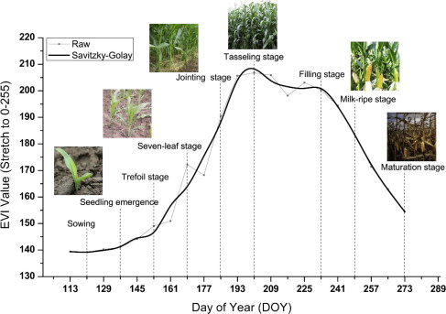
Satellite-derived features can be categorized as (1) phenological or (2) timeseries
Phenological features
Date and height of the peak
Date and height of the minimum
Date and height of the inflection point
Crop cycle length (in days)
Timeseries features
Value of EVI at each date

Slide 5
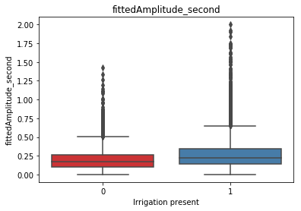
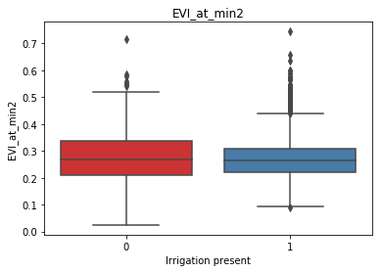
Phenological features related to the timing and height of the peak can differentiate irrigated from rainfed points. Features at other times cannot.
Related to peak height
Unrelated to the peak

Slide 6
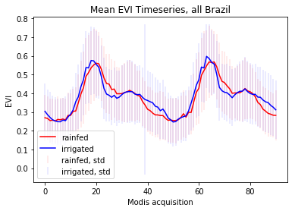
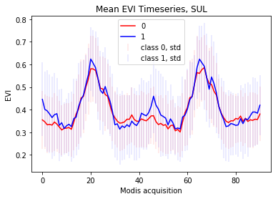
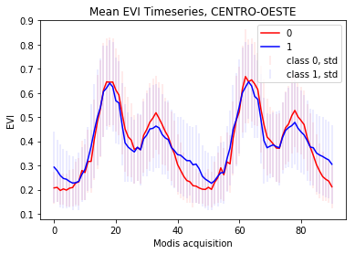
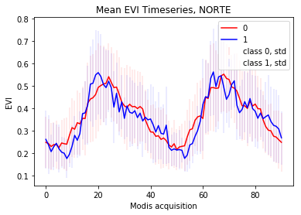
Certain times of the year can differentiate irrigated from rainfed points. The time windows that work best will differ by region.

Slide 7
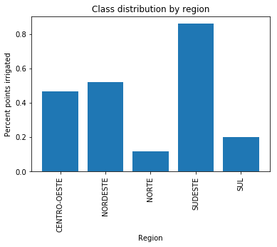
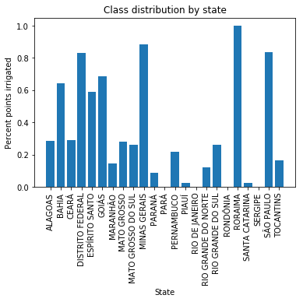
Irrigation is unevenly distributed across Brazil, indicating that geographic features would be important predictors of irrigation.
However, the inclusion of geographic predictors may result in a model that’s unable to predict the expansion of irrigation to new areas.

Slide 8
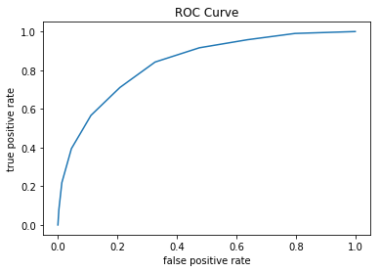
Our final model specification trains a separate random forest model for each region of Brazil to account for spatial differences in crop growth, but does not include geographic predictors.
A separate classification probability threshold is chosen for each region to maintain a consistent true positive rate across Brazil.

Slide 9
High true positives are maintained for all regions, at the expense of high false positives.
Region | Threshold | False positive rate | False negative rate | True positive rate | True negative rate | Percent irrigation in training data
South | 0.2 | 0.42 | 0.25 | 0.75 | 0.57 | 20%
Center-west | 0.4 | 0.54 | 0.12 | 0.88 | 0.45 | 47%
Southeast | 0.7 | 0.70 | 0.09 | 0.91 | 0.30 | 86%
Northeast | 0.7 | 0.57 | 0.14 | 0.85 | 0.42 | 53%
North | 0.1 | 0.70 | 0.13 | 0.87 | 0.30 | 13%
The cost of falsely detected irrigation can be mitigated by conducting ground surveys of fields predicted as irrigated.
These surveys should be targeted in regions with higher false positive rate, such as the north and southeast.

Slide 10
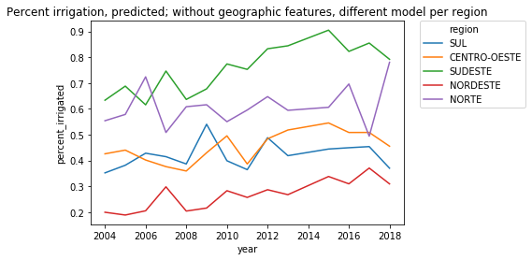
Predicted percent irrigation in each region of Brazil
Northeastern Brazil is experiencing a continuous increase in irrigation, while irrigation has declined since 2015 for most other areas. Regulations and infrastructure should focus on the rapid expansion of irrigation in the northeast.

Slide 11
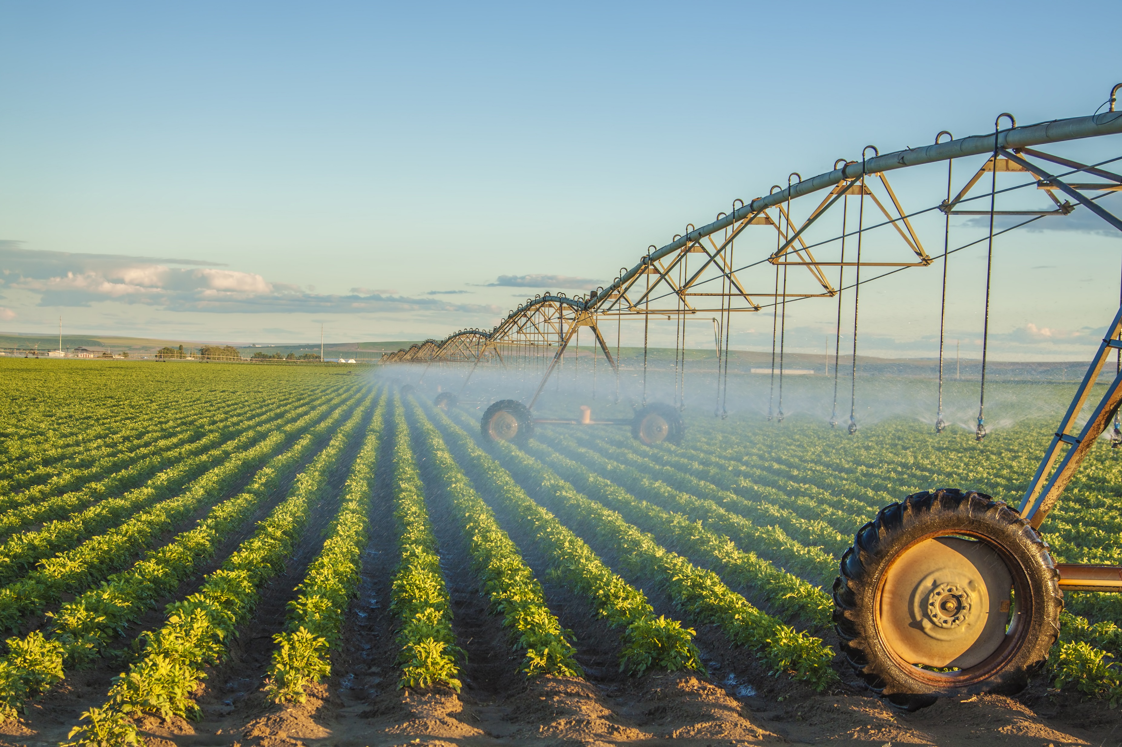
Though a high false positive rate likely produced overestimation in irrigated percent, we still detect trends in irrigation growth that can inform governmental response through infrastructure building and environmental regulations.

